Slide 1
Weekly report: Grid Code Development
Week number: 12
Date: 16/12/2025
Supervisor: Prof. Dr.-Ing. Saiju
Presented by: Vijay Simha Reddy Bogala / Josef Remberger

Slide 2
List of contents
Verification of results with requirements
Presented by: Vijay Bogala

Slide 3
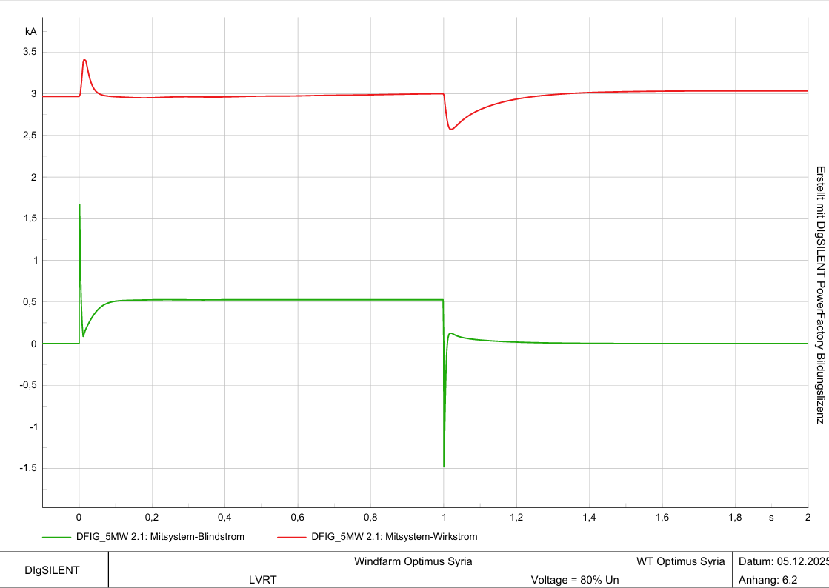
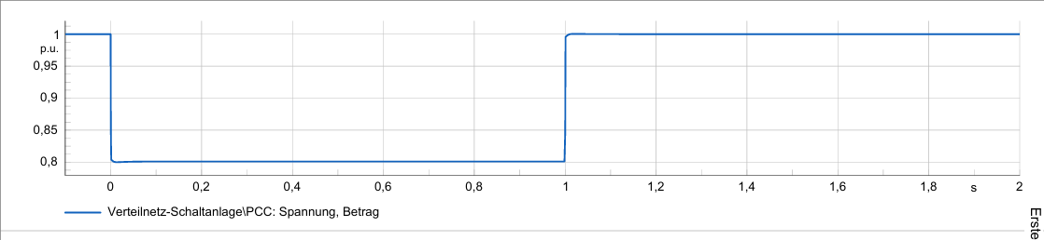
1. Verification of results
Wind turbine is connected to the grid at many situations of voltage drops and highs
  V = 0 x V_n, t = 100 ms
  V = 0.20 x V_n, t = 500 ms
  V = 0.8 x V_n, t = 1000 ms
  V = 0.9 x V_n, t = 15,000 ms
  V = 1.25 x V_n, t = 100 ms
Voltage and currents at 20% voltage drop, Source: own simulations
Presented by: Vijay Bogala

Slide 4
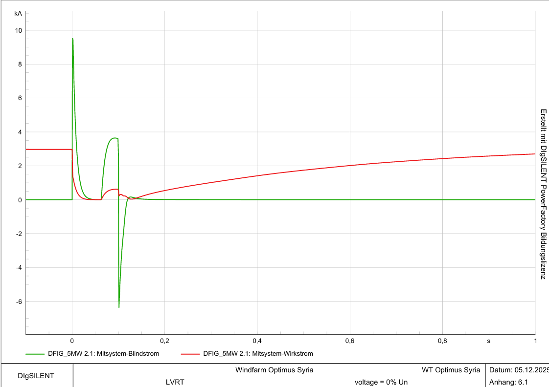
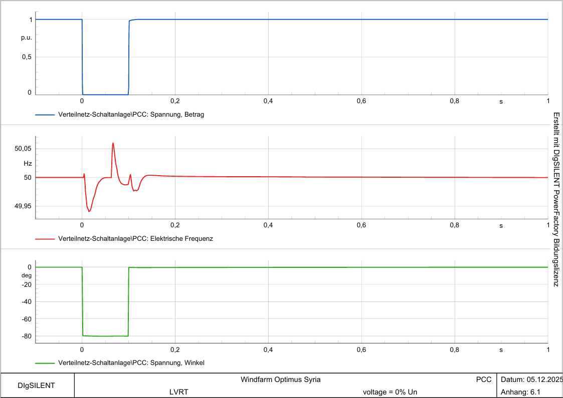

1. Verification of results
Short circuit power $I_{SC}=3×I_{r}$
([1] Syrian grid, 2012)
Source: own simulations
Presented by: Vijay Bogala

Slide 5
1. Verification of results
Wind turbine is connected to the grid at many situations of voltage drops and highs
  V = 0 x V_n, t = 100 ms
  V = 0.20 x V_n, t = 500 ms
  V = 0.8 x V_n, t = 1000 ms
  V = 0.9 x V_n, t = 15,000 ms
  V = 1.25 x V_n, t = 100 ms
Source: own simulations
Presented by: Vijay Bogala

Slide 6
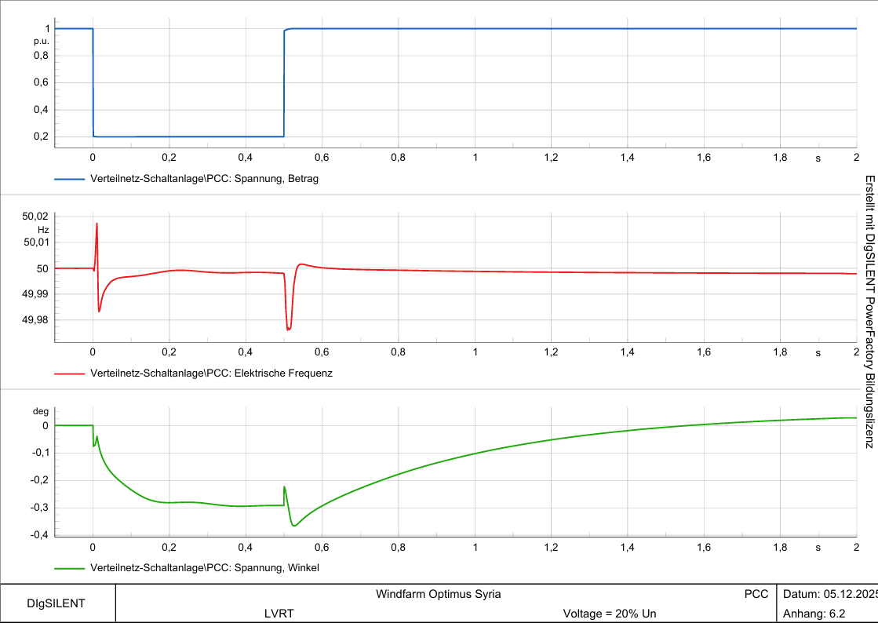
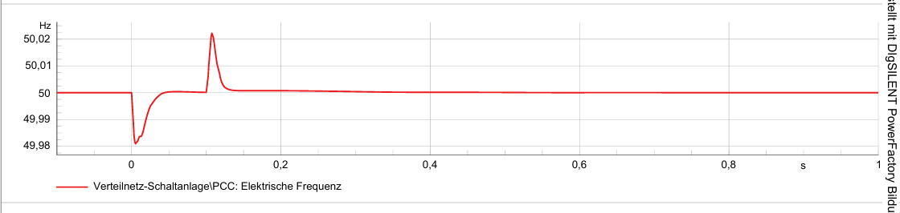
1. Verification of results
Frequency: 47.5 ≤ X ≥ 51.5 Hz
([2] Syrian grid, 2014)
Frequency graphs at different fault situations
Source: own simulations
[2]
Presented by: Vijay Bogala

Slide 7
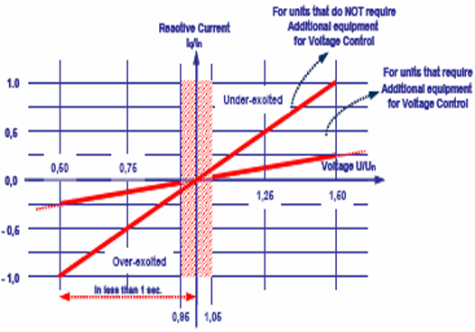
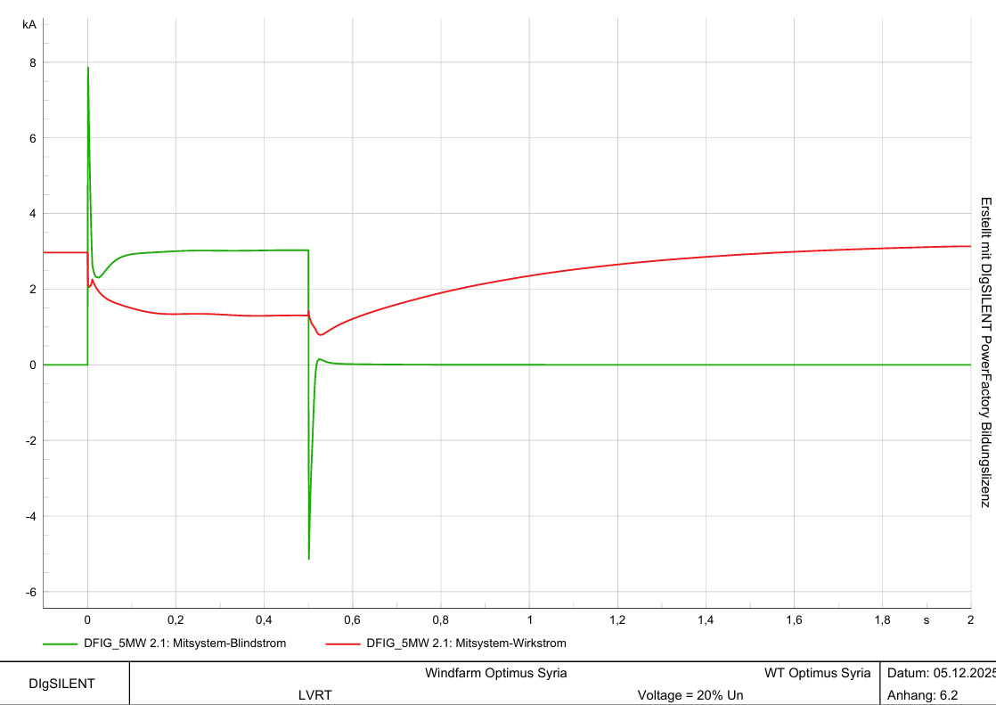
1. Verification of results
[2] Syrian grid, 2014
Reactive currents at 0 V, Source: own simulations
[2]
Presented by: Vijay Bogala

Slide 8
Bibliography – Grid Code Development
[1] “Syrian Arab Republic Ministry of Electricity Public Establishment for Transmission & Distribution of Electricity Interconnection Roles Rules and Conditions for Connecting Renewable Energy Projects to the Transmission and Distribution Networks,” 2022. Accessed: Oct. 27, 2025. [Online]. Available: https://tde.gov.sy/sites/default/files/2025-07/Rules%20and%20Conditions%20for%20Connecting%20Renewable%20Energy%20Projects%20to%20the%20Transmission%20and%20Distribution%20Networks.pdf
[2] SYRIAN ARAB REPUBLIC / Ministry of Electricity / PETE / Transmission Grid Code, 2014 (accessed Oct. 11, 2025)

